Slide 1

FNP Sales Performance
FNP Business insights from Sales Data
Presented by Mujahid Khan

Slide 2
Problem Statements
Total Revenue of Business
Total Orders
Monthly Sales Performance
Top Performing Product Categories
Revenue by Occasions
Top Performing Cities
Average Customer Spending

Slide 3
Overview of Business
Total Oders - 1000
Total Revenue - ₹3,520,984
Average Customer Spending - ₹3,521

Slide 4
Sales by Month
• We have seen a huge Demand in February, August, and November

Slide 5
Occasion wise Sales Performance
Strong trend on Anniversary and Raksha Bandhan

Slide 6
Revenue by Product Category
Categories like Colors, Soft Toys and Sweets are most demanding

Slide 7
Revenue by City
Imphal, Kavali, and Dhanbad contributed most in Revenue

Slide 8
Customer & Product Insights
Few customers who drives major revenue
We can use this Data for Targeted Advertisements for these customers

Slide 9
Conclusion and Recommendations
We are generating most sales in the month of February, August, and November.
Manage inventory in peak season.
We can make targeted Advertisements for the repeating customers

Slide 10
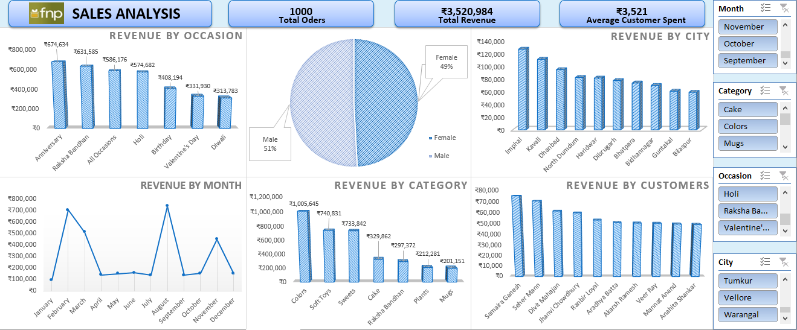
DASHBOARD

